Slide 1

About the Presentations
The presentations cover the objectives found in the opening of each chapter.
All chapter objectives are listed in the beginning of each presentation.
You may customize the presentations to fit your class needs.
Some figures from the chapters are included. A complete set of images from the book can be found on the Instructor Resources disc.
©2016. Cengage Learning. All rights reserved.

Slide 2
Oracle 12c: SQL
Chapter 2
Basic SQL SELECT Statements
©2016. Cengage Learning. All rights reserved.

Slide 3
Objectives
Create the initial database
Identify keywords, mandatory clauses, and optional clauses in a SELECT statement
Select and view all columns of a table
Select and view one column of a table
Display multiple columns of a table
©2016. Cengage Learning. All rights reserved.

Slide 4
Objectives (continued)
Use a column alias to clarify the contents of a particular column
Perform basic arithmetic operations in the SELECT clause
Remove duplicate lists using either the DISTINCT or UNIQUE keyword
Use concatenation to combine fields, literals, and other data
©2016. Cengage Learning. All rights reserved.

Slide 5
Create the JustLee Database
Use the provided script to create the database so you can follow the chapter examples
Verify table contents using the DESCRIBE command
©2016. Cengage Learning. All rights reserved.

Slide 6
SELECT Statement Syntax
SELECT statements are used to retrieve data from the database
A SELECT statement is referred to as a query
Syntax gives the basic structure, or rules, for a command
Optional clauses and keywords are shown in brackets
©2016. Cengage Learning. All rights reserved.

Slide 7

SELECT Statement Syntax (continued)
©2016. Cengage Learning. All rights reserved.

Slide 8
SELECT Statement Syntax (continued)
SELECT and FROM clauses are required
SELECT clause identifies column(s)
FROM clause identifies table(s)
Each clause begins with a keyword
©2016. Cengage Learning. All rights reserved.

Slide 9
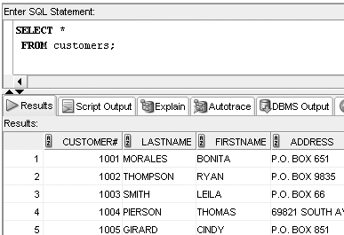
Selecting All Data in a Table
Substitute an asterisk for the column names in a SELECT clause
©2016. Cengage Learning. All rights reserved.

Slide 10
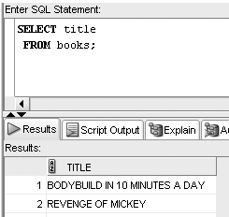
Selecting One Column from a Table
Enter column name in SELECT clause
©2016. Cengage Learning. All rights reserved.

Slide 11
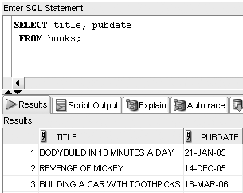
Selecting Multiple Columns from a Table
Separate column names with a comma
©2016. Cengage Learning. All rights reserved.

Slide 12
Operations within the SELECT Statement
Column alias can be used for column headings
Perform arithmetic operations
Suppress duplicates
Concatenate data
©2016. Cengage Learning. All rights reserved.

Slide 13
Using Column Aliases
List the alias after the column heading
AS keyword is optional
Enclose in double quotation marks:
  If it contains blank space(s)
  If it contains special symbol(s)
  To retain case
©2016. Cengage Learning. All rights reserved.

Slide 14
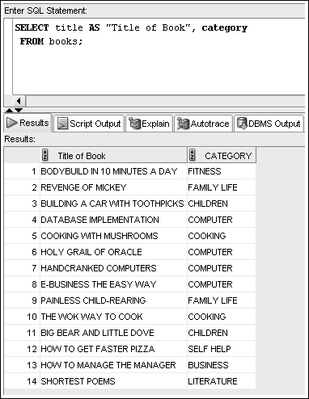
Column Alias Example
©2016. Cengage Learning. All rights reserved.

Slide 15
Using Arithmetic Operations
Arithmetic operations
  Executed left to right
  Multiplication and division are solved first
  Addition and subtraction are solved last
  Override order with parentheses
©2016. Cengage Learning. All rights reserved.

Slide 16
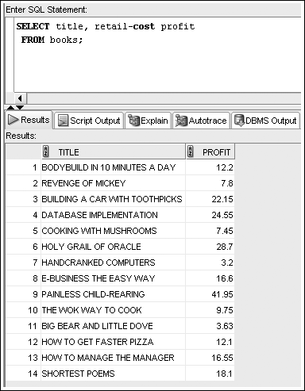
Example Arithmetic Operation with Column Alias
©2016. Cengage Learning. All rights reserved.

Slide 17
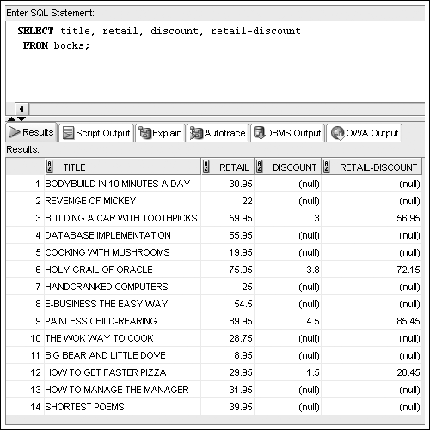
NULL Values
©2016. Cengage Learning. All rights reserved.

Slide 18
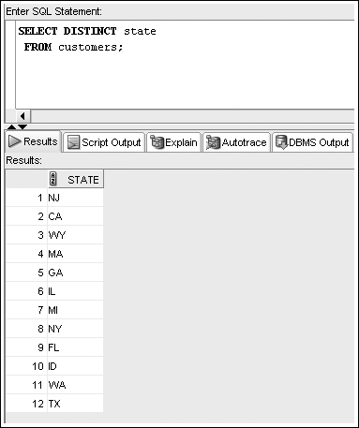
Using DISTINCT and UNIQUE
Enter DISTINCT or UNIQUE after SELECT keyword to suppress duplicates
©2016. Cengage Learning. All rights reserved.

Slide 19
Using Concatenation
You can combine data with a string literal
Use the concatenation operator, ||
It allows the use of column aliases
©2016. Cengage Learning. All rights reserved.

Slide 20
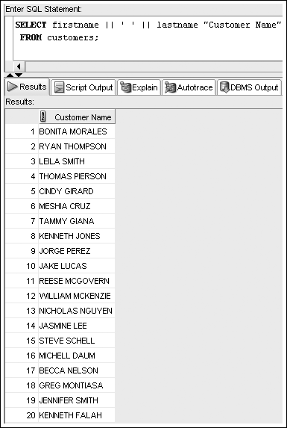
Concatenation Example
©2016. Cengage Learning. All rights reserved.

Slide 21
Summary
A basic query in Oracle 12c SQL includes the SELECT and FROM clauses, the only mandatory clauses in a SELECT statement
To view all columns in the table, specify an asterisk (*) or list all of the column names individually in the SELECT clause
To display a specific column or set of columns, list the column names in the SELECT clause (in the order in which you want them to appear)
When listing column names in the SELECT clause, a comma must separate column names
©2016. Cengage Learning. All rights reserved.

Slide 22
Summary (continued)
A column alias can be used to clarify the contents of a particular column; if the alias contains spaces or special symbols, or if you want to display the column with any lowercase letters, you must enclose the column alias in double quotation marks (" ")
Indicate the table name following the FROM keyword
Basic arithmetic operations can be performed in the SELECT clause
NULL values indicate an absence of a value
©2016. Cengage Learning. All rights reserved.

Slide 23
Summary (continued)
To remove duplicate listings, include either the DISTINCT or UNIQUE keyword
To specify which table contains the desired columns, you must list the name of the table after the keyword FROM
Use vertical bars (||) to combine, or concatenate, fields, literals, and other data
©2016. Cengage Learning. All rights reserved.

